Slide 1
Health and Safety Update
NZISM
Greg Cain

Slide 2
Recent cases – sentencing trends
- Stumpmaster v WorkSafe New Zealand
- Oceana Gold (New Zealand) Ltd v WorkSafe New Zealand
- WorkSafe New Zealand v Stevens and Stevens Ltd
Health
- Asbestos (WorkSafe New Zealand v Knight)
- Dust (WorkSafe New Zealand v Precision Animal Supplements)
- Fatigue
- Employment law (bullying and sexual harassment)
Enforceable undertakings
- Circumstances
- Content
Proposed new regulations on plant etc
Outline

Slide 3
Stumpmaster v WorkSafe New Zealand [2018] NZHC 2020
Added an additional step to the sentencing approach
1. Assess amount of reparation
2. Assess fine amount (sentencing bands + aggravating and mitigating factors)
3. Assess further orders
4. Assess overall proportionality and appropriateness (and adjust if necessary)
Set sentencing bands under new maximum penalties
No formal impact on reparation

Slide 4
Oceana Gold (New Zealand) Ltd v WorkSafe New Zealand [2019] NZHC 365
Deals with the amount of reparations after the increase in fines under the HSWA
Victim died
Reparations can cover loss that impacts the victim’s family (rather than the victim directly)
Reparations calculated as expected income less accident compensation payments, over the period of ACC cover

Slide 5
WorkSafe New Zealand v Stevens and Stevens [2018] NZDC 19098
Worker rode quadbike over hazardous terrain. Bike rolled and killed her
Stevens and Stevens pleaded guilty
Fine of $306,000 and $75,000 reparation
Lower discount than previous cases in reliance on Stumpmaster

Slide 6
Inability to pay
Stumpmaster, Sentencing Act and cases all consider financial capacity relevant.
The court is willing to make reductions if imposing a fine will mean the business has to close.
- Can pay fines in instalments
- Or waive a fine completely
But have to balance with not letting businesses get away with health and safety violations

Slide 7
Health
Increased focus on the ‘health’ aspects of health and safety
Potential health risks:
- asbestos
- dust
- fatigue
- bullying
- sexual harassment

Slide 8
Asbestos: WorkSafe New Zealand v Knight [2018] NZDC 24613
Engaged by property developer to remove asbestos from a house in a residential area.
Starting point of $10,000
Reduced due to mitigating factors
Reduced further due to inability to pay

Slide 9
Dust: WorkSafe New Zealand v Precision Animal Supplements [2018] NZDC 19342
Manufactured animal products which contained toxic substances
Manufacture process created a lot of dust
Not enough steps taken to mitigate risk (ventilation was installed but was insufficient, masks provided but were not up to standard)
Ability to pay taken into account setting the fine

Slide 10
Enforceable undertakings
Criteria for qualifying for an enforceable undertaking
Common features of enforceable undertakings
- Increasing cost
- Donations
- Specific health and safety commitments
Are EUs a thing of the past?

Slide 11
New regulations discussion paper
MBIE released discussion paper on plant, structures, working at heights, scaffolding and excavations
Existing rules are hard to understand, out of date, full of gaps and ad hoc
Paper sets out ideas for new rules to manage risks

Slide 12
Options
MBIE has proposals to improve rules around
- Plant in the workplace
- Designing and manufacturing plant and structures
- Risky equipment
- Working at heights and scaffolding
- Excavation work

Slide 13
Offences
Discussion paper sets out types of offences
- Regulatory
- Infringement
Question of which type of offence a breach of the options in the document should be

Slide 14
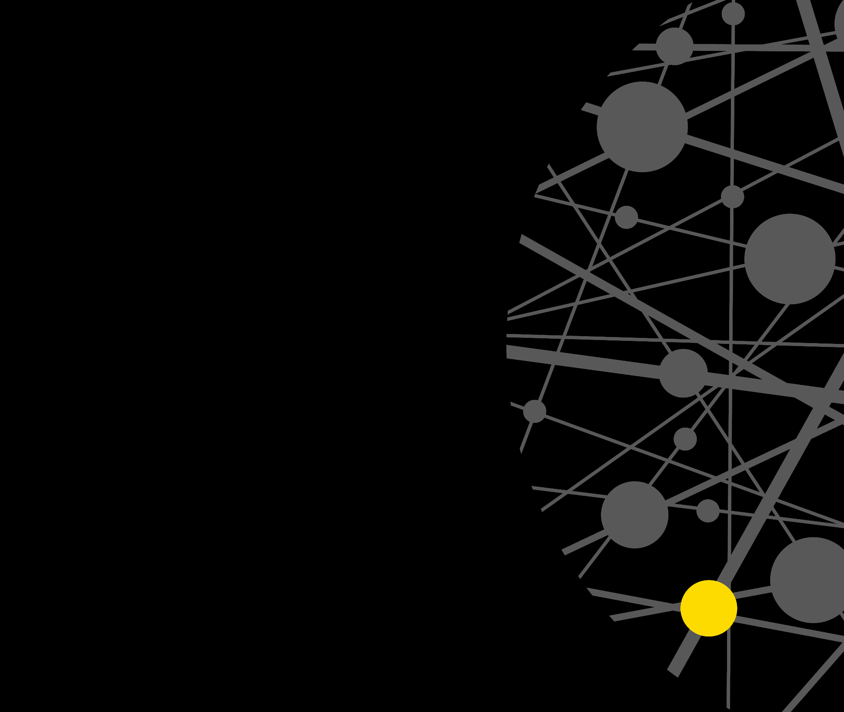
Thank you.
contact
Greg Cain
Partner
greg.cain@kensingtonswan.com
DDI
|
+64 4 916 0963
M
+64 21 770 936

